Slide 1

HK TREE WATCH
A natural science survey system
http://www.hktreewatch.org
Notes:
Hello, we are HK TREE WATCH. My name is Rishi and allow me to briefly talk about our Project aims and Objective with this application We built this application to meet the functional requirements of our client.
What we will show you today is the very early alpha demonstration of our natural science survey system, with a focus on tree management and survey knowledge for the general public. We hope to improve this application, with your valuable feedback as time goes on .

Slide 2
VISION
To enable researchers and the general public to report on Hong Kong's diverse flora & fauna.
Create a love of nature
Notes:
So what is our VISION, and why did we build this app?As the description says we want to enable researches and the general public to gain knowledge and insight from Hong Kong’s unique and diverse ecosystem. We hope that this application will help many organizations including our client to uplift the quality of their living environment through active planning, maintenance and preservation of trees and other vegetation. To summarize, in one line, we hope that our application can simply “CREATE A LOVE OF NATURE” , in fact this is what our client had requested.

Slide 3
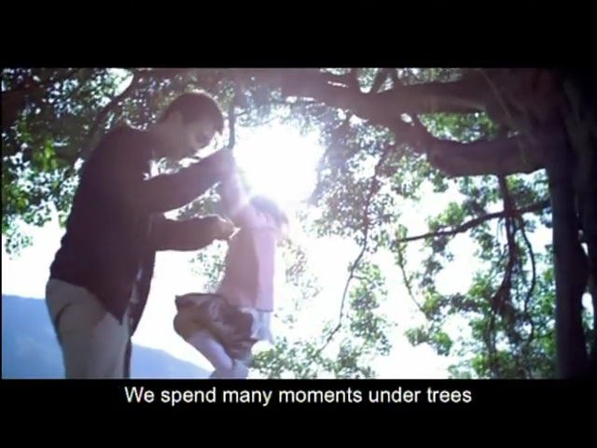
VIDEO
Before we being the demonstration, I want to introduce a short video which will summarise our goals, in fact this video was created by the HK Government and was recently showcased on TVB pearl, this video will clearly highlight our aims and objective.
source: ISD, Hong Kong Government
Notes:
Before we being the demonstration, I want to introduce a short video which will correctly summarize our goals, in fact this video was created by the Government and was recently showcased on TVB pearl, this video will clearly highlight our aim and objective.
I hope now you better understand why we build our application and why we need the general public support and NGO’s to monitor and survey our trees & bio diversity.

Slide 4
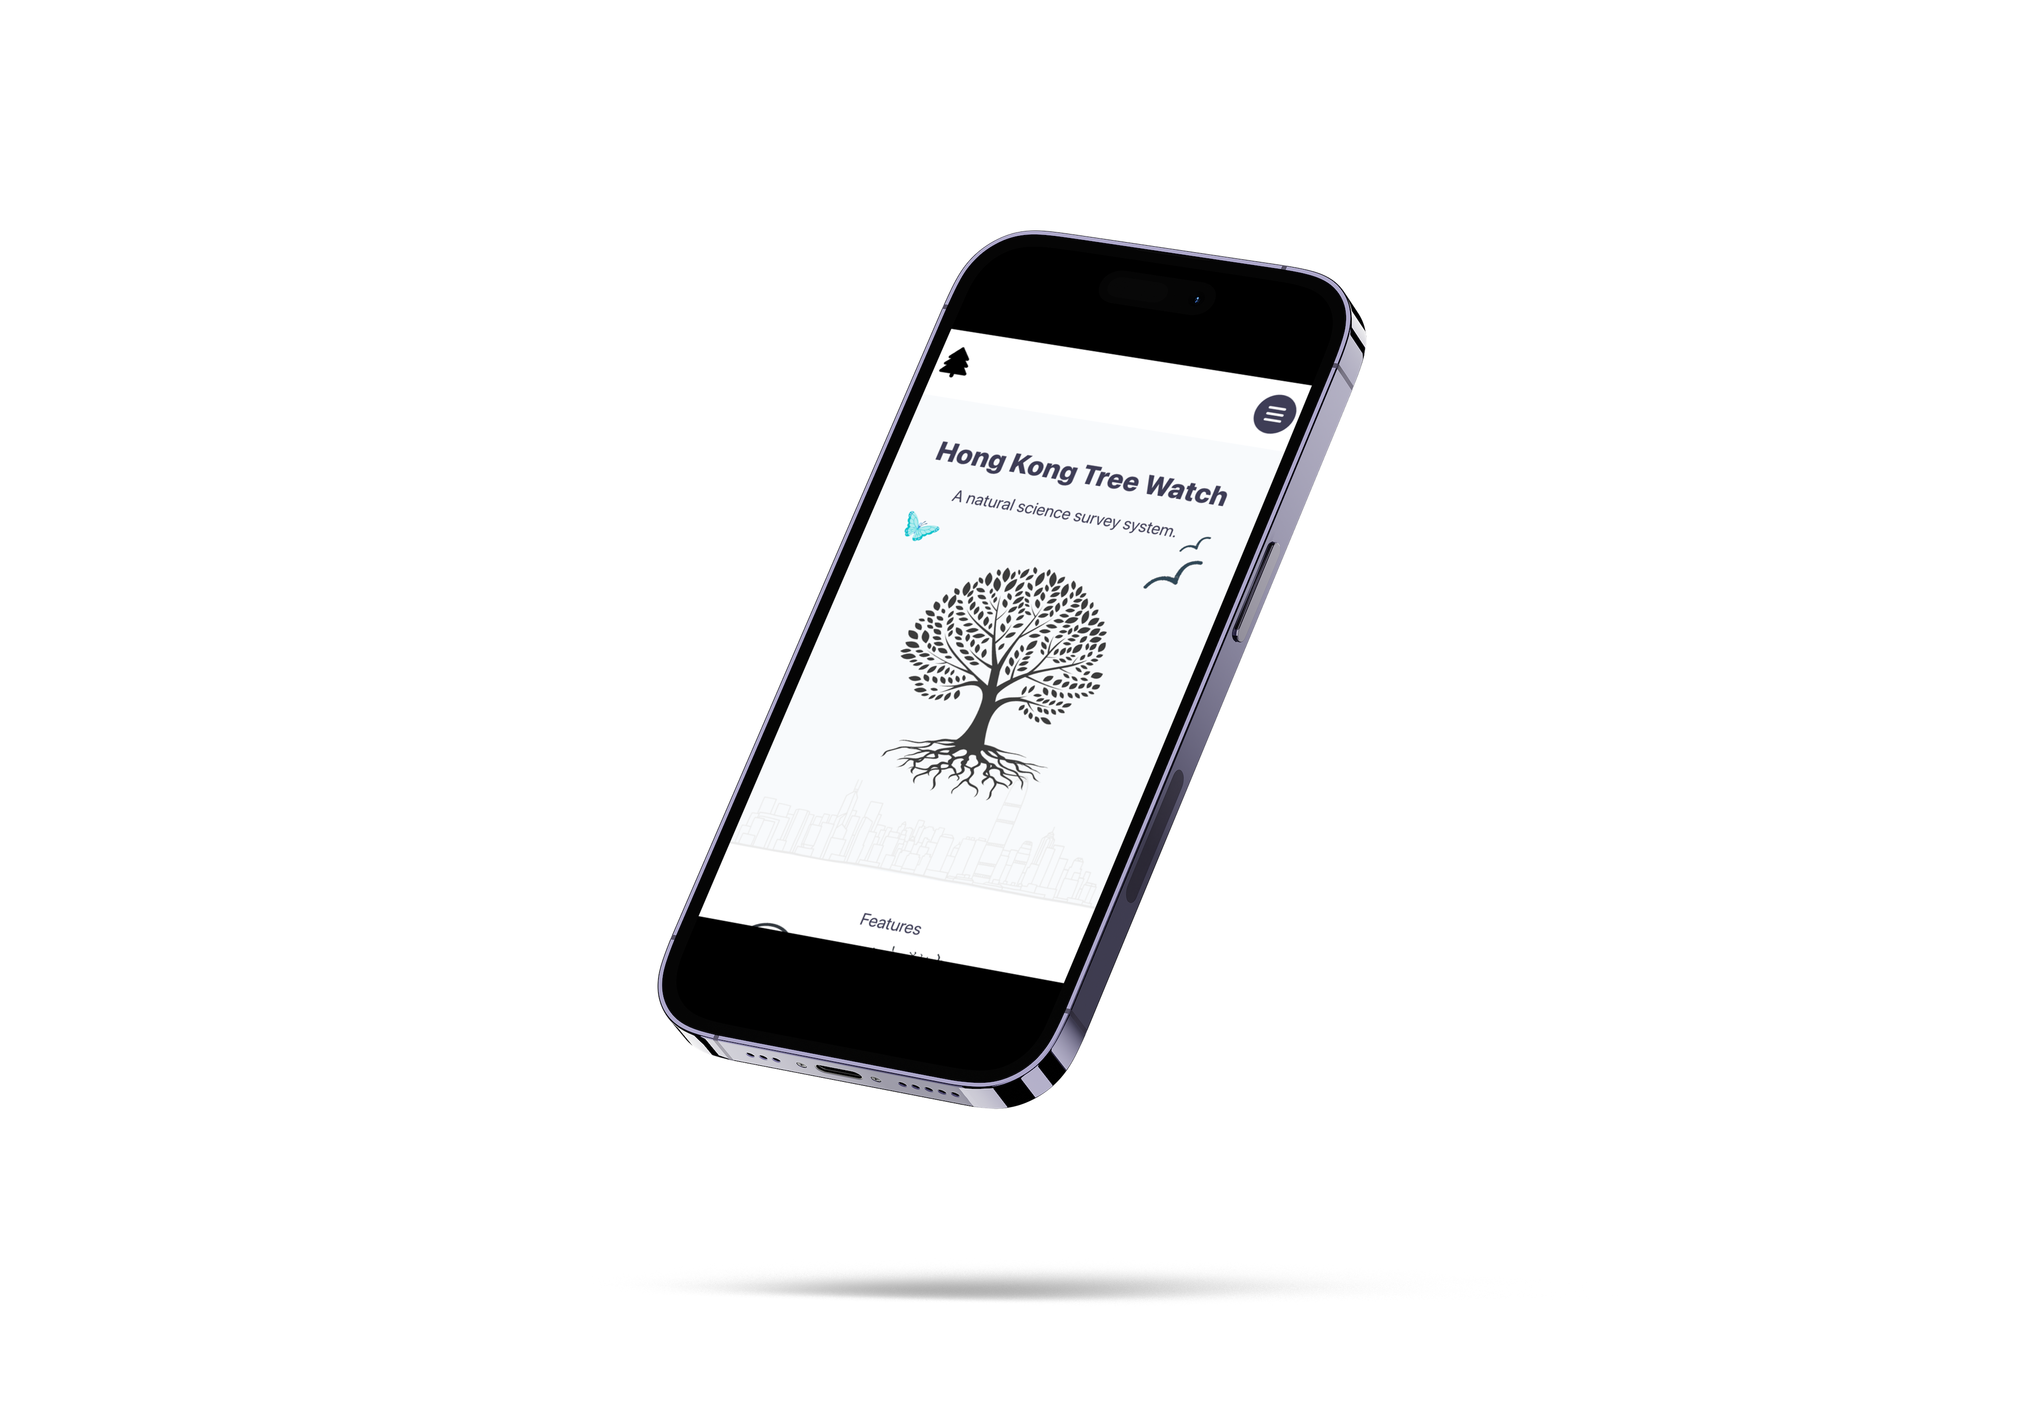
PEOPLE, TREES, HARMONY
How can we achieve this?
Modern UI/UX
Responsive
~1.5s loading time
Single code base / Multi platform
Follows common design principles
Follow clients branding theme
Accessible
Secure (OWASP compliant)
Engagement
Notes:
How will our Achieve this?
- Modern user interface, legible text, good contrast with background and foreground, remember that our application will likely be used outdoors most of the time.
Responsive which means any device, anywhere with the same functionality, we can’t code for all devices and sizes, and with a limited budget responsible makes the most sense.
Single code base, this is mainly for Developer experience and maintainability for future developers who are working on our repository.
Follow common design principles, which include (Visibility, Good user Feedback, Constraints for different activitie and , Consistency across screens & Affordance which is to make the application easy to use without needing a 500 page manual to understand it.
Security is very important, if we are handling sensitive user data we must follow some core OWASP principles. At this stage it is a work in progress but we hope to complete it soon.
Engagement, there is no use to build a app if no body is going to use it, so we have plans to get as many hands on our application, and we will talk about this in our final demonstration to the client.

Slide 5
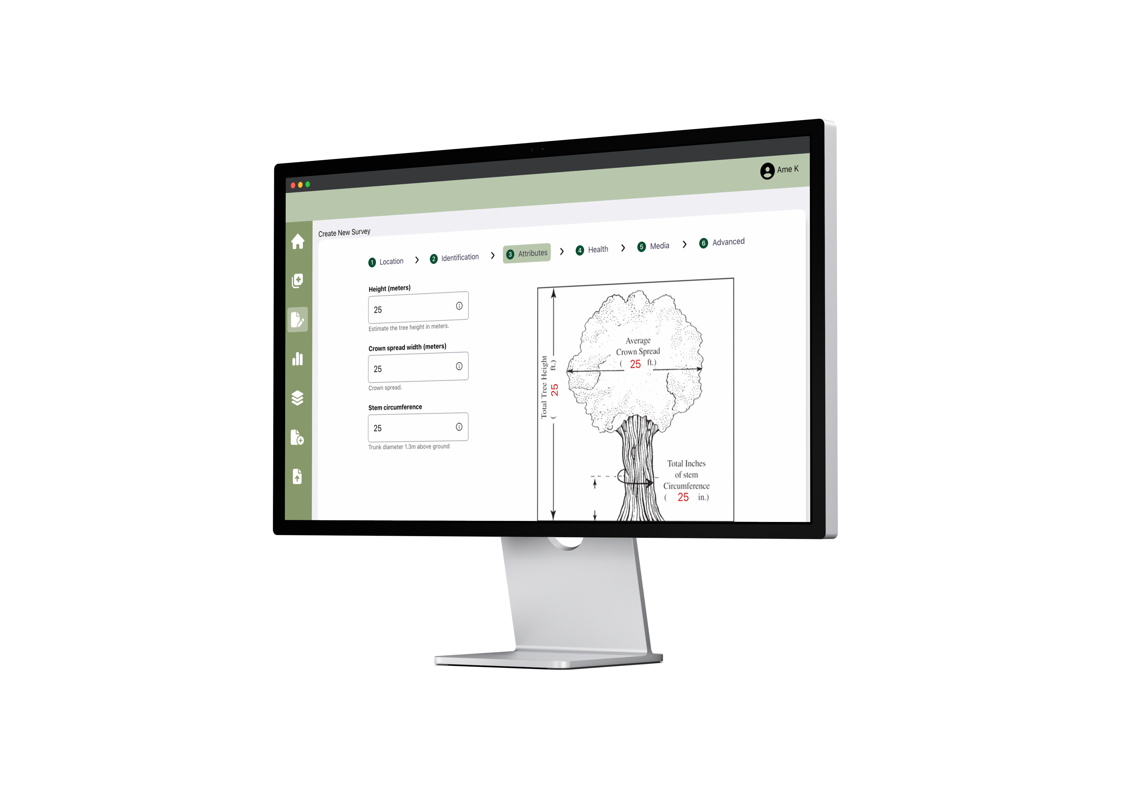
CMS
Knowledge base
Gamification
Adaptable
Charts
User behaviour analytics
Dark & Light Mode
Integration with Government API’s
+ many more
Notes:
Of course we have a lot of other features in our product roadmap which we will show you later in our product plan, but some of the features we plan to introduce later include this.
The possibilities are endless given the time available.

Slide 6
Product Demo
Notes:
Demno Time.

Slide 7
Product Plan Overview
Our full product plan is available for viewing in our repository shared with you earlier, below are some highlights and progress updates. Please visit our shared repo for more information.
High Level Overview & Product Scope
Provide a comprehensive & consistent method for both beginner and advanced surveyors to record and retrieve tree species data by observation.
Evaluate changes associated with tree species over time & boost engagement with general public.
Progress Update (Product Backlog, not shared with the client during demo)
Create a more engaging landing page experience for the general public after comments from the client.
Remove the long copy writing on the Home page and replace with a gallery of highlighted images.
Fix security issues on the backend e.g TLS certificate, MD5 Hashing of passwords, http-only cookies, provide consistent typeface on UI.
Decide which one of the clients new requirements are within the scope of the initial Project Plan, and prioritize the backlog accordingly.
Prevent scope creep in order not to delay the project beyond the requirements already outlined.
Prepare for our 4th Sprint Week.

